Slide 1

Biodiversity I – intro, definitions, and why it matters
Petr Keil
Notes:
Hi, my name is Petr Keil and this is my project Biodiversity dynamics across a continuum of space, time, and their scales.

Slide 2
History, general concepts, definitions
“Biodiversity is a charismatic mega-category” (Díaz & Malhi 2022)
Notes:
I am qualified to deliver all this

Slide 3
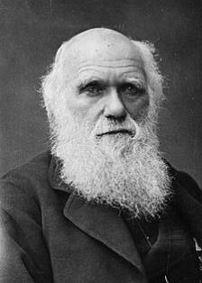
Biodivesity – a one-slide history of the concept
Charles Darwin – the Entangled Bank
The last paragraph of On the Origin of Species:
"It is interesting to contemplate a tangled bank, clothed with many plants of many kinds, with birds singing on the bushes, with various insects flitting about, and with worms crawling through the damp earth, and to reflect that these elaborately constructed forms, so different from each other, and dependent upon each other in so complex a manner, have all been produced by laws acting around us. These laws, taken in the largest sense, being Growth with reproduction; Inheritance which is almost implied by reproduction; Variability from the indirect and direct action of the conditions of life, and from use and disuse; a Ratio of Increase so high as to lead to a Struggle for Life, and as a consequence to Natural Selection, entailing Divergence of Character and the Extinction of less improved forms. Thus, from the war of nature, from famine and death, the most exalted object which we are capable of conceiving, namely, the production of the higher animals, directly follows. There is grandeur in this view of life, with its several powers, having been originally breathed by the Creator into a few forms or into one; and that, whilst this planet has gone circling on according to the fixed law of gravity, from so simple a beginning endless forms most beautiful and most wonderful have been, and are being evolved."
Darwin (1859) On the Origin of Species.
3
Notes:
In this panel we can probably all agree that biodiversity is one of the most valuable natural resources.
But things like climate change or habitat loss are a threat to biodiversity, to the extent that we hear about biodiversity crisis, or sixth mass extinction
For example, about 1% of vertebrate species have gone extinct because of humans

Slide 4
Biodiversity – a one-slide history of the concept
1916 – J. Arthur Harris used concept of biological diversity in natural history of US deserts
1980 – The term in its current meaning in T.E. Lovejoy’s book on conservation biology
Throughout the 80’: Folks like W.G. Rosen, E. Norse, E.O. Wilson raise the term to prominence. Also, it’s generalized to “biological variability among, and also below and beyond, the level of species”
1992 – United Nations Conference of Environment and Development (the Rio summit)
1993 – United Nations Convention on Biological Diversity (CBD), Article 2: “the variability among living organisms from all sources including, inter alia, terrestrial, marine, and the ecological complexes of which they are part: this includes diversity within species, between species, and of ecosystems”
Current IPBES definition: “The variability among living organisms from all sources including terrestrial, marine and other aquatic ecosystems and the ecological complexes of which they are part. This includes variation in genetic, phenotypic, phylogenetic, and functional attributes, as well as changes in abundance and distribution over time and space within and among species, biological communities, and ecosystems”
“variation of life at all levels of biological organization” (Gaston & Spicer 2009)
Díaz & Malhi (2022) Annual Review of Environment and Rsources
Notes:
In this panel we can probably all agree that biodiversity is one of the most valuable natural resources.
But things like climate change or habitat loss are a threat to biodiversity, to the extent that we hear about biodiversity crisis, or sixth mass extinction
For example, about 1% of vertebrate species have gone extinct because of humans

Slide 5
The diversity of biodiversities – biodiversity is multidimensional
Across many species
Taxonomic diversity – number of species
Phylogenetic diversity – diversity which incorporates phylogenetic (evolutionary) difference between species
Functional diversity – range of functional traits
Within a single species
Genetic diversity – number of genetic characteristics of a species (i.e. combined differences in the DNA of all individuals of a species)
Morphological diversity
Phenotypic plasticity - the ability of individual genotypes to produce different phenotypes when exposed to different environmental conditions
Landscape
Ecosystem or habitat diversity, resource diversity
Notes:
In this panel we can probably all agree that biodiversity is one of the most valuable natural resources.
But things like climate change or habitat loss are a threat to biodiversity, to the extent that we hear about biodiversity crisis, or sixth mass extinction
For example, about 1% of vertebrate species have gone extinct because of humans

Slide 6
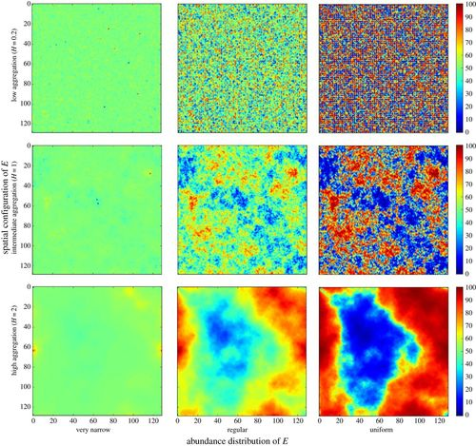
Closely related concepts: Heterogeneity, variability, complexity
Bar Massada et al. (2014) Proceedings of the Royal Society B
Notes:
In this panel we can probably all agree that biodiversity is one of the most valuable natural resources.
But things like climate change or habitat loss are a threat to biodiversity, to the extent that we hear about biodiversity crisis, or sixth mass extinction
For example, about 1% of vertebrate species have gone extinct because of humans

Slide 7
Remotely sensed habitat heterogeneity
Free GIS layers on EarthEnv, Tuanmu & Jetz (2015) Global Ecology and Biogeography
Notes:
In this panel we can probably all agree that biodiversity is one of the most valuable natural resources.
But things like climate change or habitat loss are a threat to biodiversity, to the extent that we hear about biodiversity crisis, or sixth mass extinction
For example, about 1% of vertebrate species have gone extinct because of humans

Slide 8
Measuring biodiversity
Notes:
I am qualified to deliver all this

Slide 9
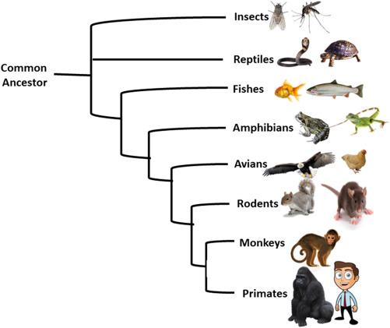
Number of species (Taxonomic diversity) vs Phylogenetic diversity
Phylogeny
Community
Image: Nixon (2001) Encyclopedia of Biodiversity
Notes:
In this panel we can probably all agree that biodiversity is one of the most valuable natural resources.
But things like climate change or habitat loss are a threat to biodiversity, to the extent that we hear about biodiversity crisis, or sixth mass extinction
For example, about 1% of vertebrate species have gone extinct because of humans

Slide 10
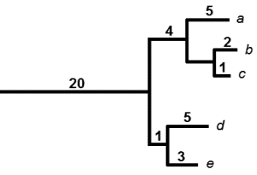
Faith’s phylogenetic diversity (PD)
PD = sum of branch lengths = 20 + 5 + 4 + 2 + 1 + 5 + 1 + 3
Faith (1992) Biological Conservation
Notes:
In this panel we can probably all agree that biodiversity is one of the most valuable natural resources.
But things like climate change or habitat loss are a threat to biodiversity, to the extent that we hear about biodiversity crisis, or sixth mass extinction
For example, about 1% of vertebrate species have gone extinct because of humans

Slide 11
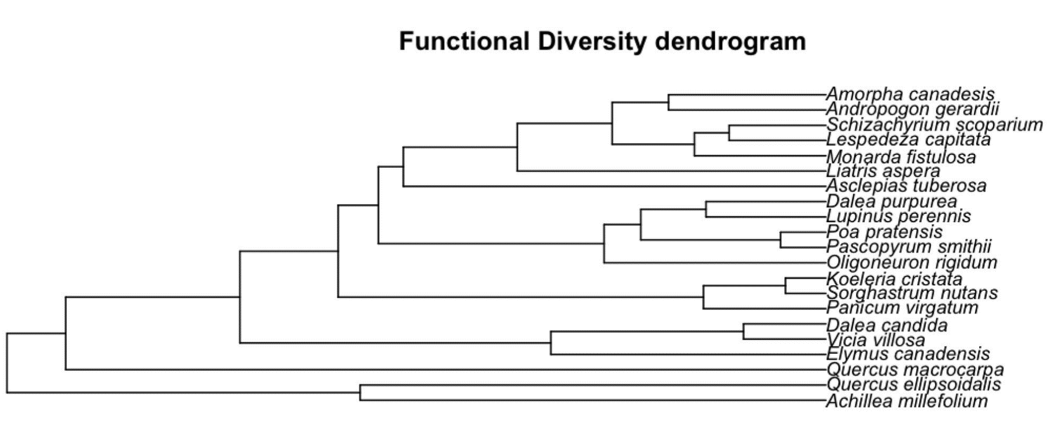
Functional diversity (FD)
FD = sum of branch lengths
Dissimilarity of functional traits
Notes:
In this panel we can probably all agree that biodiversity is one of the most valuable natural resources.
But things like climate change or habitat loss are a threat to biodiversity, to the extent that we hear about biodiversity crisis, or sixth mass extinction
For example, about 1% of vertebrate species have gone extinct because of humans

Slide 12
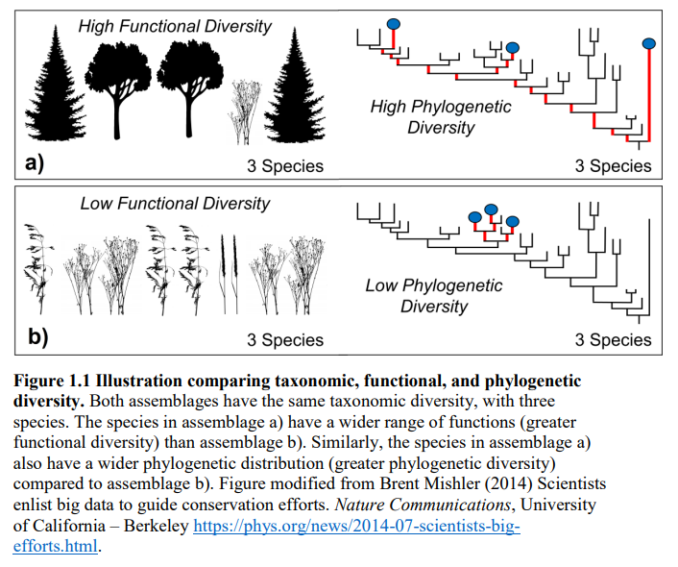
Note: Taxonomic, phylogenetic, and functional diversity are correlated
Notes:
In this panel we can probably all agree that biodiversity is one of the most valuable natural resources.
But things like climate change or habitat loss are a threat to biodiversity, to the extent that we hear about biodiversity crisis, or sixth mass extinction
For example, about 1% of vertebrate species have gone extinct because of humans

Slide 13
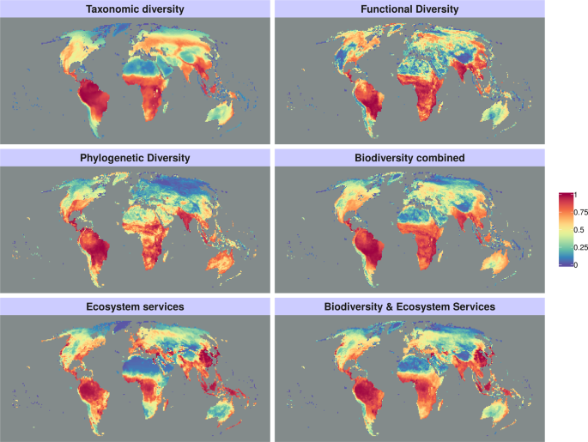
Global patterns of diversity of birds and mamals
Girardello et al. 2019 Scientific Reports
Notes:
In this panel we can probably all agree that biodiversity is one of the most valuable natural resources.
But things like climate change or habitat loss are a threat to biodiversity, to the extent that we hear about biodiversity crisis, or sixth mass extinction
For example, about 1% of vertebrate species have gone extinct because of humans

Slide 14
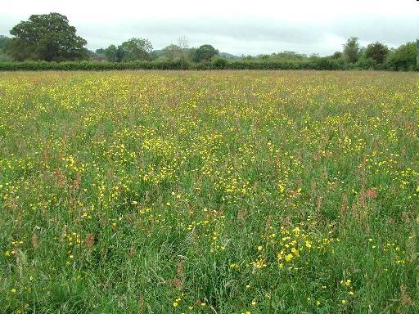
Incidence vs abundance-based diversity
Species | Abundance (# of individuals) | Incidence (presence or absence)
Phleum pratense | 25 | 1
Ranunculus acris | 20 | 1
Dactylis glomerata | 10 | 1
Taraxacum officinale | 8 | 1
Veronica chamaedris | 3 | 1
Trifolium hybridum | 2 | 1
Lotus corniculatus | 1 | 1
Lathyrus pratensis | 1 | 1
Vicia villosa | 0 | 0
Anthoxanthum odoratum | 0 | 0
Poa annua | 0 | 0
Community
Notes:
In this panel we can probably all agree that biodiversity is one of the most valuable natural resources.
But things like climate change or habitat loss are a threat to biodiversity, to the extent that we hear about biodiversity crisis, or sixth mass extinction
For example, about 1% of vertebrate species have gone extinct because of humans

Slide 15
Species-abundance distribution
Rank-abundance diagram
Histogram
Notes:
In this panel we can probably all agree that biodiversity is one of the most valuable natural resources.
But things like climate change or habitat loss are a threat to biodiversity, to the extent that we hear about biodiversity crisis, or sixth mass extinction
For example, about 1% of vertebrate species have gone extinct because of humans

Slide 16
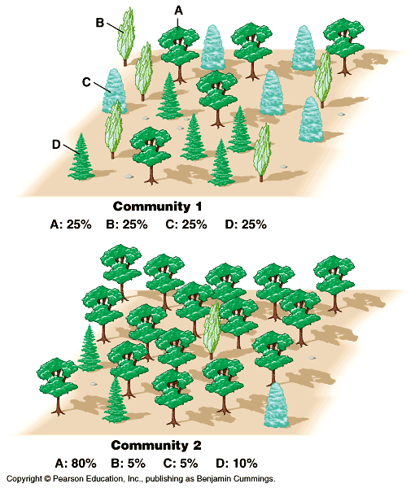
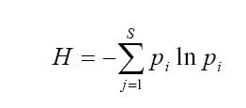
Abundance-based indices of diversity
Shannon-Wiener index:
Species rank
Species rank
Notes:
In this panel we can probably all agree that biodiversity is one of the most valuable natural resources.
But things like climate change or habitat loss are a threat to biodiversity, to the extent that we hear about biodiversity crisis, or sixth mass extinction
For example, about 1% of vertebrate species have gone extinct because of humans

Slide 17
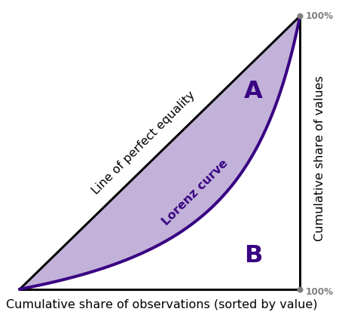
Evenness
G = A / (A+B)
Species rank
Cumulative abundance
Species Rank
(from lowest to highest)
Species rank
Gini Graphs: Kimberley Fessel
Notes:
In this panel we can probably all agree that biodiversity is one of the most valuable natural resources.
But things like climate change or habitat loss are a threat to biodiversity, to the extent that we hear about biodiversity crisis, or sixth mass extinction
For example, about 1% of vertebrate species have gone extinct because of humans

Slide 18
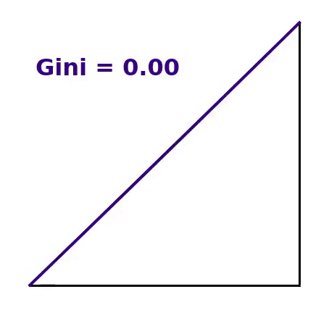
Evenness
G = A / (A+B)
Species rank
Cumulative abundance
Species Rank
(from lowest to highest)
Species rank
Gini Graphs: Kimberley Fessel
Notes:
In this panel we can probably all agree that biodiversity is one of the most valuable natural resources.
But things like climate change or habitat loss are a threat to biodiversity, to the extent that we hear about biodiversity crisis, or sixth mass extinction
For example, about 1% of vertebrate species have gone extinct because of humans

Slide 19
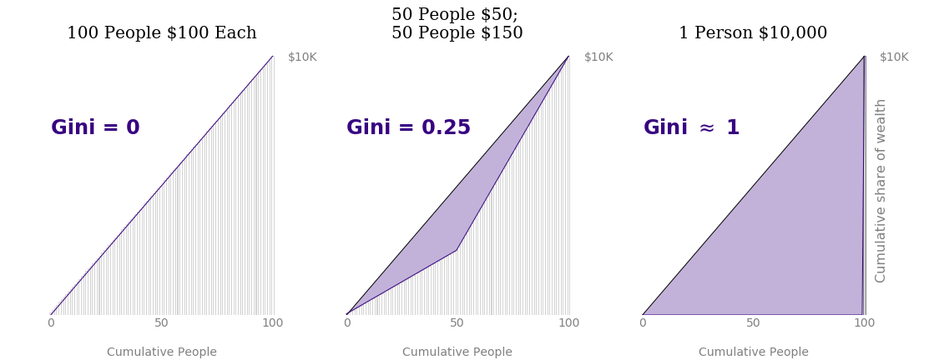
Evenness
Gini Graphs: Kimberley Fessel
Notes:
In this panel we can probably all agree that biodiversity is one of the most valuable natural resources.
But things like climate change or habitat loss are a threat to biodiversity, to the extent that we hear about biodiversity crisis, or sixth mass extinction
For example, about 1% of vertebrate species have gone extinct because of humans

Slide 20
Alpha, beta, and gamma diversity
α
γ
β = γ/α
Whittaker R. H. (1960) Ecological Monographs
Notes:
In this panel we can probably all agree that biodiversity is one of the most valuable natural resources.
But things like climate change or habitat loss are a threat to biodiversity, to the extent that we hear about biodiversity crisis, or sixth mass extinction
For example, about 1% of vertebrate species have gone extinct because of humans

Slide 21
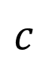
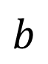
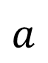
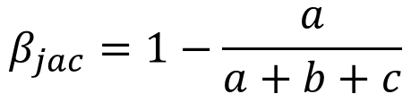
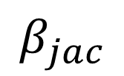
Similarity (or dissimilarity) – more than 80 indices for binary data
Example: Jaccard index
$$β_{jac}=1−\frac{a}{a+b+c}$$
$$a$$
$$b$$
$$c$$
$$β_{jac}$$
1
1
1
1
1
1
Sites
1
1
1
1
Species
Koleff et al. (2003) Journal of Animal Ecology
Legendre & Legendre (2012) Numerical Ecology
Notes:
In this panel we can probably all agree that biodiversity is one of the most valuable natural resources.
But things like climate change or habitat loss are a threat to biodiversity, to the extent that we hear about biodiversity crisis, or sixth mass extinction
For example, about 1% of vertebrate species have gone extinct because of humans

Slide 22
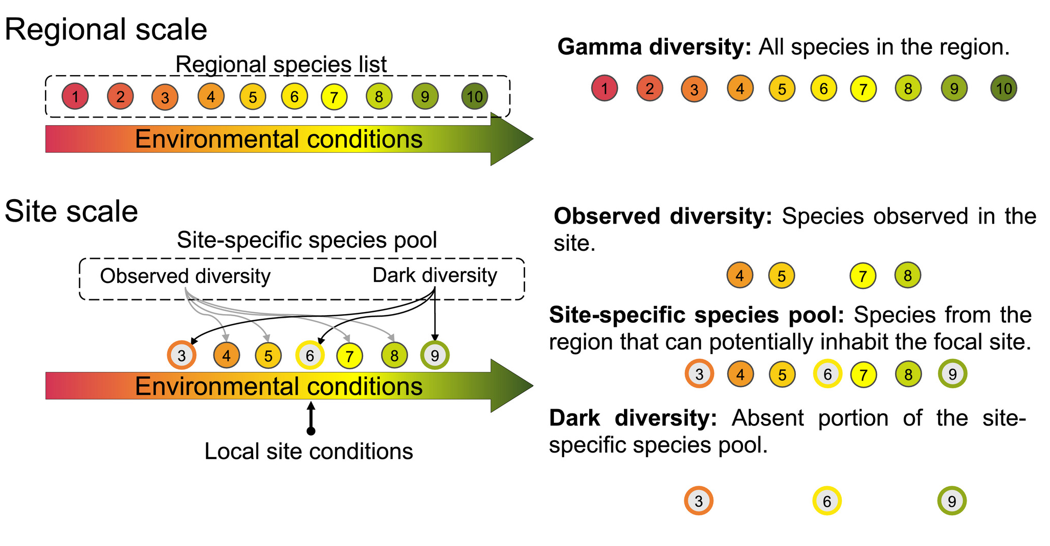
Species pools, dark diversity
Carmona & Partel (2021) Global Ecology & Biogeography
Notes:
In this panel we can probably all agree that biodiversity is one of the most valuable natural resources.
But things like climate change or habitat loss are a threat to biodiversity, to the extent that we hear about biodiversity crisis, or sixth mass extinction
For example, about 1% of vertebrate species have gone extinct because of humans

Slide 23
You should know
The difference between taxonomic, phylogenetic, and functional diversity
How are these measured (species richness, FD, PD)
The difference between abundance-based and incidence-based metrics
What is species-abundance distribution
The difference between diversity and evenness
What is alpha, beta, and gamma diversity
What are species pools
Notes:
In this panel we can probably all agree that biodiversity is one of the most valuable natural resources.
But things like climate change or habitat loss are a threat to biodiversity, to the extent that we hear about biodiversity crisis, or sixth mass extinction
For example, about 1% of vertebrate species have gone extinct because of humans

Slide 24
Why biodiversity matters
Notes:
I am qualified to deliver all this

Slide 25
Two views on why biodiversity matters
Biocentric views
favor intrinsic values
unrelated to humans
entities irreplaceable
Championed by nature lovers and conservationists
-> Ecosystem function, functional traits
Anthropocentric views
favor human-focused values
strongly instrumental
entities often seem replaceable
-> Ecosystem services, Nature’s contribution to people
Díaz & Malhi (2022) Annual Review of Environment and Resources
Notes:
In this panel we can probably all agree that biodiversity is one of the most valuable natural resources.
But things like climate change or habitat loss are a threat to biodiversity, to the extent that we hear about biodiversity crisis, or sixth mass extinction
For example, about 1% of vertebrate species have gone extinct because of humans

Slide 26
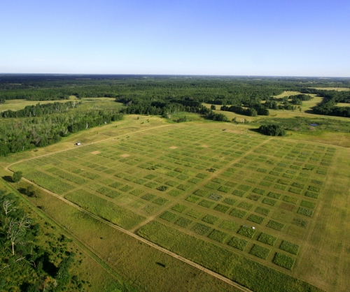
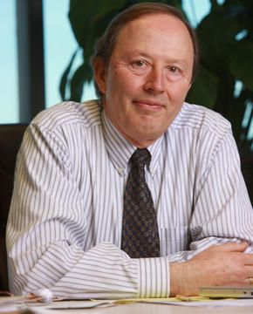
Biodiversity-ecosystem function (BEF): productivity
David Tilman:
More diverse communities are more productive.
Tilman & Downing (1994) Nature
Loreau et al. (2001) Science
Notes:
In this panel we can probably all agree that biodiversity is one of the most valuable natural resources.
But things like climate change or habitat loss are a threat to biodiversity, to the extent that we hear about biodiversity crisis, or sixth mass extinction
For example, about 1% of vertebrate species have gone extinct because of humans

Slide 27
Biodiversity-ecosystem function (BEF): stability
Initial treatment species number
Tilman, Reich & Knops (2006) Nature
Notes:
In this panel we can probably all agree that biodiversity is one of the most valuable natural resources.
But things like climate change or habitat loss are a threat to biodiversity, to the extent that we hear about biodiversity crisis, or sixth mass extinction
For example, about 1% of vertebrate species have gone extinct because of humans

Slide 28
Mechanisms behind the diversity-productivity relationship: Biodiversity effects
Complementarity – each species has different sets of traits, and exploits different niche
Example: Grasslands, where each species takes nutrients from different depths, grows at different time, and tolerates different shade intensity.
Sampling effect – the more species we sample from species pool, the higher the chance that we sample a productive one
Loreau et al. (2001) Science
Notes:
In this panel we can probably all agree that biodiversity is one of the most valuable natural resources.
But things like climate change or habitat loss are a threat to biodiversity, to the extent that we hear about biodiversity crisis, or sixth mass extinction
For example, about 1% of vertebrate species have gone extinct because of humans

Slide 29
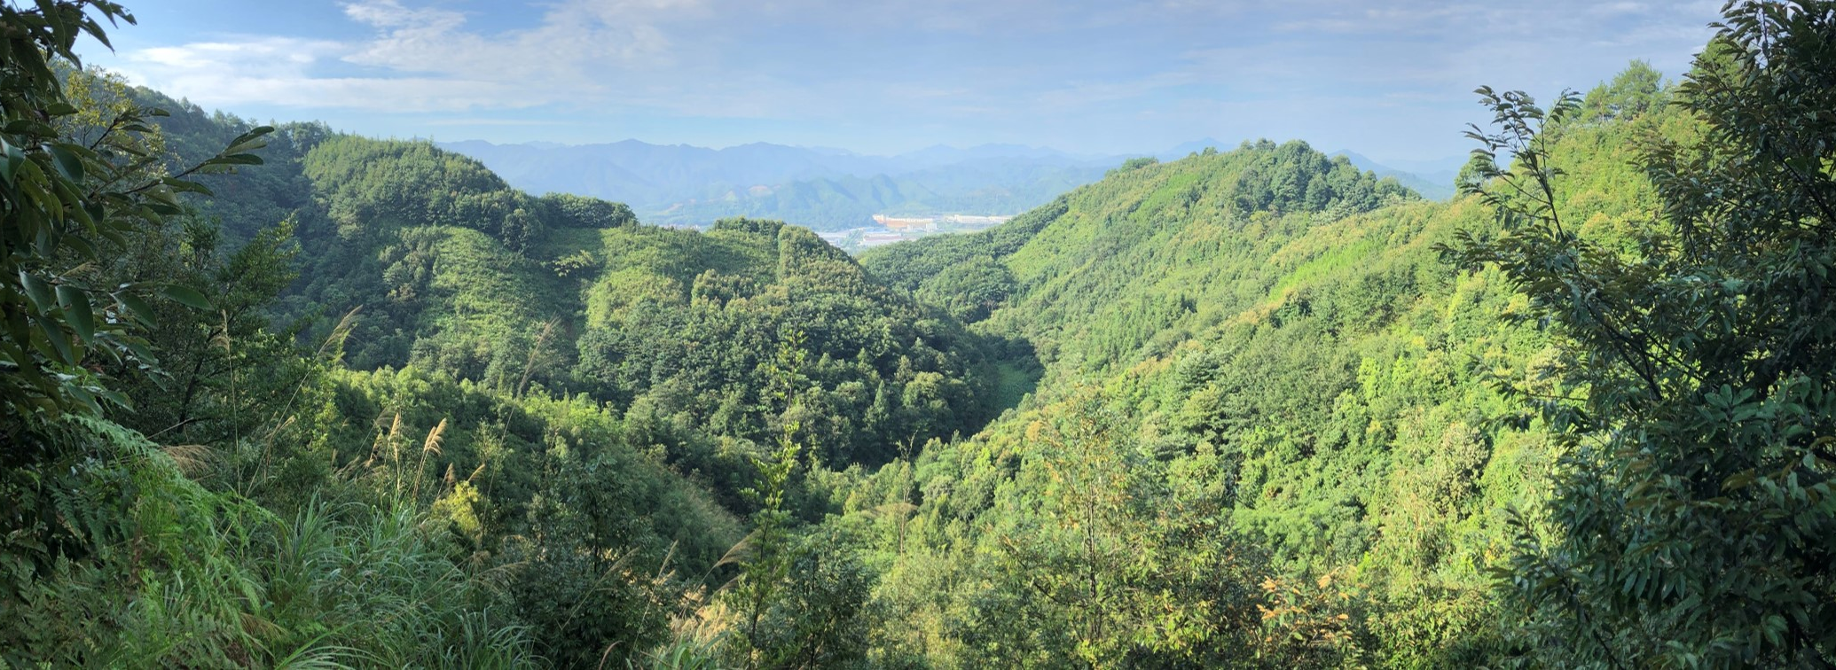
BEF in Chinese subtropical forest experiment
Huang et al. (2018) Science
bef-china.com
Notes:
In this panel we can probably all agree that biodiversity is one of the most valuable natural resources.
But things like climate change or habitat loss are a threat to biodiversity, to the extent that we hear about biodiversity crisis, or sixth mass extinction
For example, about 1% of vertebrate species have gone extinct because of humans

Slide 30
BEF in global observational data
Duffy et al. (2017) Nature
Notes:
In this panel we can probably all agree that biodiversity is one of the most valuable natural resources.
But things like climate change or habitat loss are a threat to biodiversity, to the extent that we hear about biodiversity crisis, or sixth mass extinction
For example, about 1% of vertebrate species have gone extinct because of humans

Slide 31
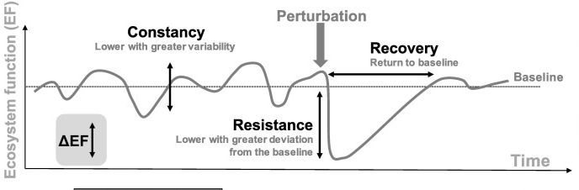
Biodiversity effects: stability
De Bello et al. (2021) Trends in Ecology and Evolution
Notes:
In this panel we can probably all agree that biodiversity is one of the most valuable natural resources.
But things like climate change or habitat loss are a threat to biodiversity, to the extent that we hear about biodiversity crisis, or sixth mass extinction
For example, about 1% of vertebrate species have gone extinct because of humans

Slide 32
Mechanisms: stability
Three main mechanisms behind biodiversity-stability relationship :
Asynchrony of species responses to environmental fluctuations
Differences at speed at which species respond to perturbations
Reduction in the strength of competition
Loreau & Mazancourt (2013) Ecology Letters
Notes:
In this panel we can probably all agree that biodiversity is one of the most valuable natural resources.
But things like climate change or habitat loss are a threat to biodiversity, to the extent that we hear about biodiversity crisis, or sixth mass extinction
For example, about 1% of vertebrate species have gone extinct because of humans

Slide 33
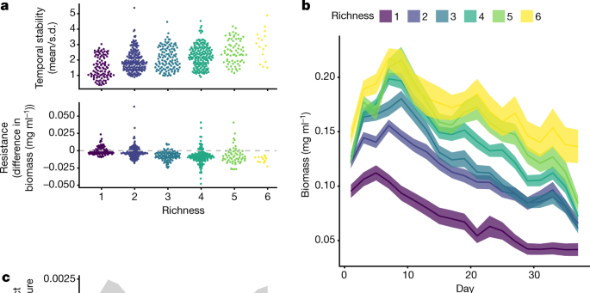
Empirical support for diversity-stability
It depends on how stability is defined!
Pennekamp et al. (2018) Nature
Notes:
In this panel we can probably all agree that biodiversity is one of the most valuable natural resources.
But things like climate change or habitat loss are a threat to biodiversity, to the extent that we hear about biodiversity crisis, or sixth mass extinction
For example, about 1% of vertebrate species have gone extinct because of humans

Slide 34
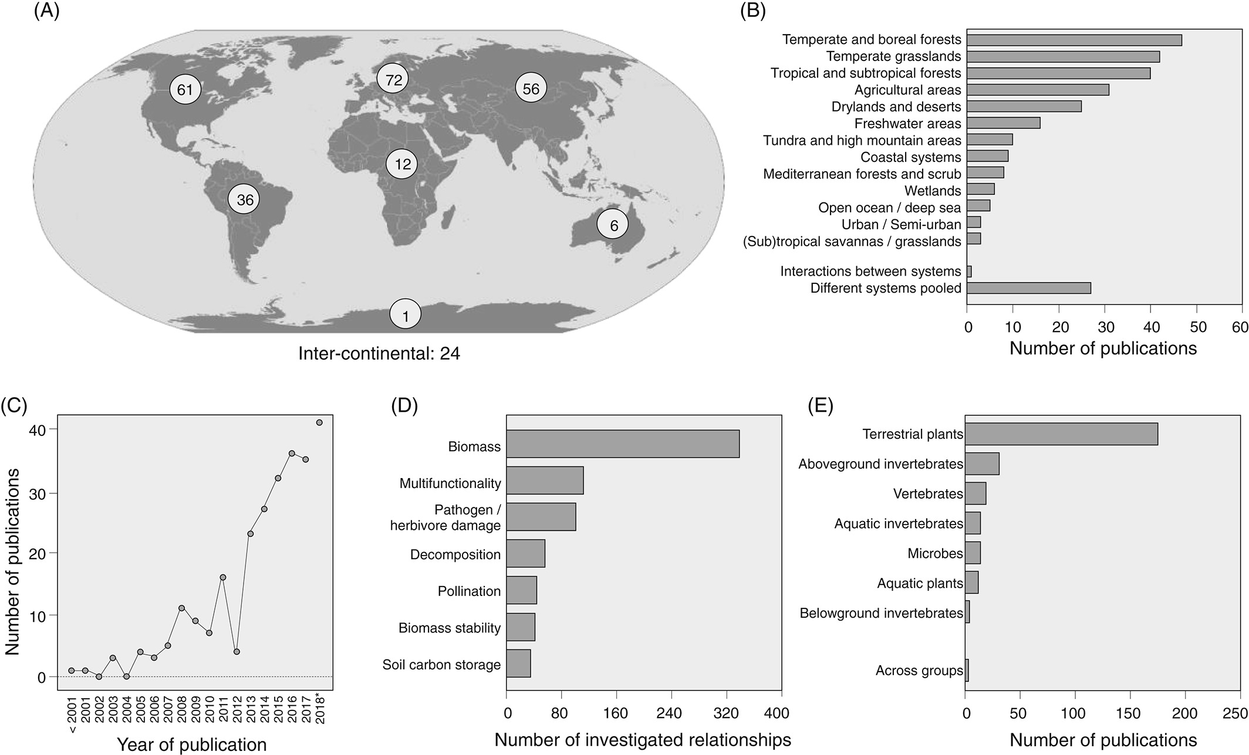
Empirical support for BEF in natural systems – a metaanalysis by van der Plas (2019)
van der Plas (2019) Biological Reviews
Notes:
In this panel we can probably all agree that biodiversity is one of the most valuable natural resources.
But things like climate change or habitat loss are a threat to biodiversity, to the extent that we hear about biodiversity crisis, or sixth mass extinction
For example, about 1% of vertebrate species have gone extinct because of humans

Slide 35
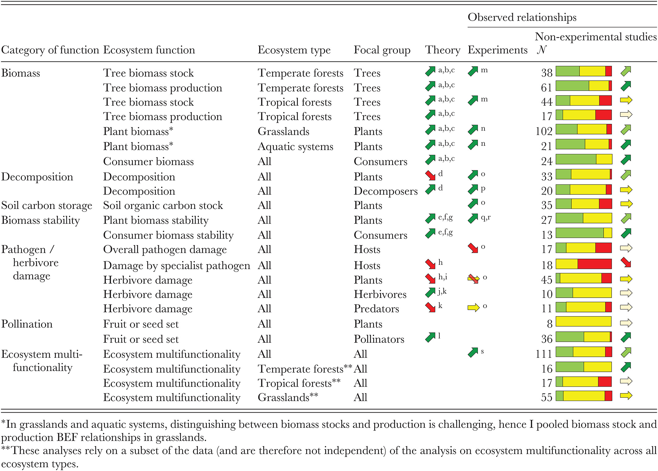
Empirical support for BEF in natural systems – a metaanalysis by van der Plas (2019)
Productivity
Stability
van der Plas (2019) Biological Reviews
Notes:
In this panel we can probably all agree that biodiversity is one of the most valuable natural resources.
But things like climate change or habitat loss are a threat to biodiversity, to the extent that we hear about biodiversity crisis, or sixth mass extinction
For example, about 1% of vertebrate species have gone extinct because of humans

Slide 36
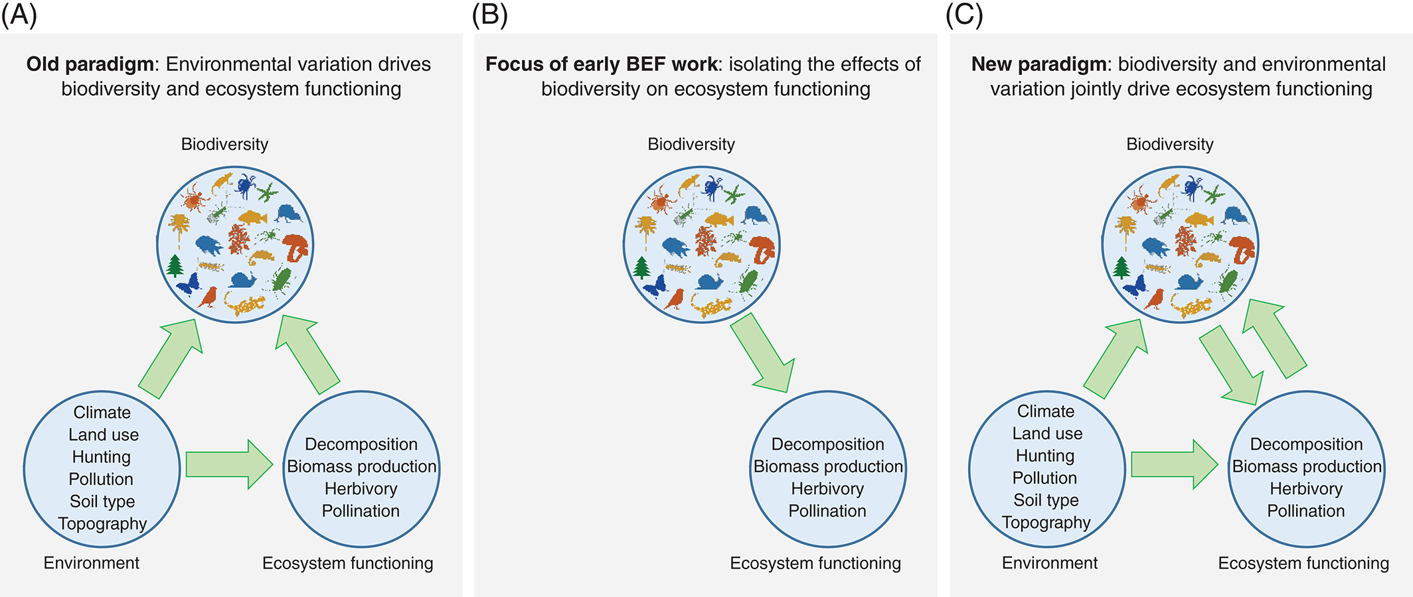
View on BEF has shifted
van der Plas (2019) Biological Reviews
Notes:
In this panel we can probably all agree that biodiversity is one of the most valuable natural resources.
But things like climate change or habitat loss are a threat to biodiversity, to the extent that we hear about biodiversity crisis, or sixth mass extinction
For example, about 1% of vertebrate species have gone extinct because of humans

Slide 37
You should know
There is a prevalent (empirically and experimentally supported) positive biodiversity-productivity relationship
The main mechanisms behind it are:
Higher likelihood of having (sampling) a high-productivity species if we sample species from species pool
Complementarity effects
There are multiple relationships between biodiversity and stability, depending on how we define stability, and the whole science behind biodiversity-stability relationship is more complex
You should be able to name at least 1 other BEF relationship
Notes:
In this panel we can probably all agree that biodiversity is one of the most valuable natural resources.
But things like climate change or habitat loss are a threat to biodiversity, to the extent that we hear about biodiversity crisis, or sixth mass extinction
For example, about 1% of vertebrate species have gone extinct because of humans

Slide 38
Thank you. Questions?

